Slide 1
ICT407: IT Governance in Organisations
Week 8:
Lecturer: Dr. Farshid Keivanian

Slide 2
Introduction to IT Governance, Risk, and Compliance (IT GRC)
Introductory Statement: IT Governance, Risk, and Compliance (IT GRC) is a framework that ensures that IT supports and enables the overall business strategy, while managing risks and complying with regulations.

Slide 3
Introduction to IT Governance, Risk, and Compliance (IT GRC)
Practical Scenario: Consider a large financial institution in Sydney that needs to ensure its IT systems are aligned with business objectives, mitigate cybersecurity risks, and comply with local regulations like the Australian Privacy Principles (APPs).
Class Discussion:
Question: Why is it important for an organization to have a strong IT GRC framework in place?
Response: IT GRC ensures that IT aligns with business goals, mitigates risks, and complies with regulations, which is crucial for maintaining trust and avoiding legal issues.

Slide 4
Introduction to IT Governance, Risk, and Compliance (IT GRC)
Multiple-Choice Question: Question: What is the primary goal of IT Governance? a) To increase IT expenses b) To minimize employee workload
c) To ensure IT aligns with business strategy d) To limit IT system usage

Slide 5
Key Principles of IT Governance
Introductory Statement: The key principles of IT governance include alignment, accountability, transparency, risk management, and performance measurement.

Slide 6
Key Principles of IT Governance
Practical Scenario: Imagine a tech startup in Melbourne that must establish clear roles and responsibilities for its IT team, ensuring accountability and transparency in decision-making processes.
Class Discussion:
Question: How can transparency in IT decision-making benefit an organization?
Response: Transparency ensures that stakeholders are informed, which builds trust and facilitates better decision-making.

Slide 7
Key Principles of IT Governance
Open-Ended Question:
Question: Can you think of an example where lack of accountability in IT governance led to a business failure?
Follow-Up Question:
Question: How could proper IT governance have prevented that failure?
Explanation: IT governance is about making sure IT decisions align with the business’s overall goals, ensuring clear accountability, transparency, and managing risks effectively.

Slide 8
Objectives of IT Governance, Risk, and Compliance (GRC)
Introductory Statement: The main objectives of GRC are to ensure that IT supports business goals, manages risks, and meets compliance requirements.

Slide 9
Objectives of IT Governance, Risk, and Compliance (GRC)
Practical Scenario: A retail company in Brisbane needs to ensure that its IT systems are secure and compliant with the Payment Card Industry Data Security Standard (PCI DSS) to protect customer data.
Class Discussion:
Question: What could be the consequences of failing to comply with IT regulations?
Response: Non-compliance can lead to legal penalties, loss of customer trust, and financial losses.

Slide 10
Objectives of IT Governance, Risk, and Compliance (GRC)
Open-Ended Question:
Question: How does GRC help in creating a risk-aware environment within a business?
Follow-Up Question: Question: What role does compliance play in reducing business risks?
Explanation: GRC helps businesses make informed decisions by creating a risk-aware environment, ensuring compliance with regulations, and aligning IT with business objectives.

Slide 11
Why is GRC Important?
Introductory Statement: GRC is crucial because it helps businesses navigate risks and comply with regulatory requirements in a rapidly changing environment.

Slide 12
Why is GRC Important?
Practical Scenario: A healthcare provider in Canberra must comply with the Australian Privacy Principles to ensure patient data is protected and secure.
Class Discussion:
Question: Why is it important for businesses to be risk-aware in today’s environment?
Response: Being risk-aware helps businesses anticipate and mitigate potential threats, ensuring long-term success and stability.

Slide 13
Why is GRC Important?
Open-Ended Question:
Question: Can you identify a situation where failing to manage IT risks led to significant consequences for a business?
Follow-Up Question:
Question: How could a better GRC framework have helped mitigate those risks?
Explanation: GRC is important because it helps businesses manage risks, comply with regulations, and make informed decisions in a complex business landscape.

Slide 14
What Drives GRC?
Introductory Statement: The key drivers of GRC include increased cyber risks, regulatory requirements, data privacy needs, and the complexity of modern business relationships.

Slide 15
What Drives GRC?
Practical Scenario: A logistics company in Sydney faces increasing risks due to the complex relationships with third-party vendors and needs to ensure its IT systems are secure and compliant.
Class Discussion:
Question: How do third-party relationships increase IT risks?
Response: Third-party relationships can introduce vulnerabilities, making it harder to control data security and compliance.

Slide 16
What Drives GRC?
Open-Ended Question: Question: What strategies can businesses use to manage the risks associated with third-party relationships?
Follow-Up Question: Question: How does compliance with data privacy laws help in mitigating these risks?
Explanation: GRC is driven by the need to manage cyber risks, comply with regulations, and ensure that businesses can operate securely in a complex and interconnected environment.

Slide 17
Group Class Activity – Presentation (Calibri Size 28 - f.keivanian@aapoly.edu.au)
Task: Design a basic IT governance framework for a fictitious company in Sydney. Each group should identify the key principles of governance, such as alignment, accountability, and transparency, and explain how these principles will be applied in the company’s IT strategy.
Discussion: Each group should present their framework, explaining their decisions and any challenges they faced. Consider how your governance framework would help the company manage risks and comply with regulations.

Slide 18
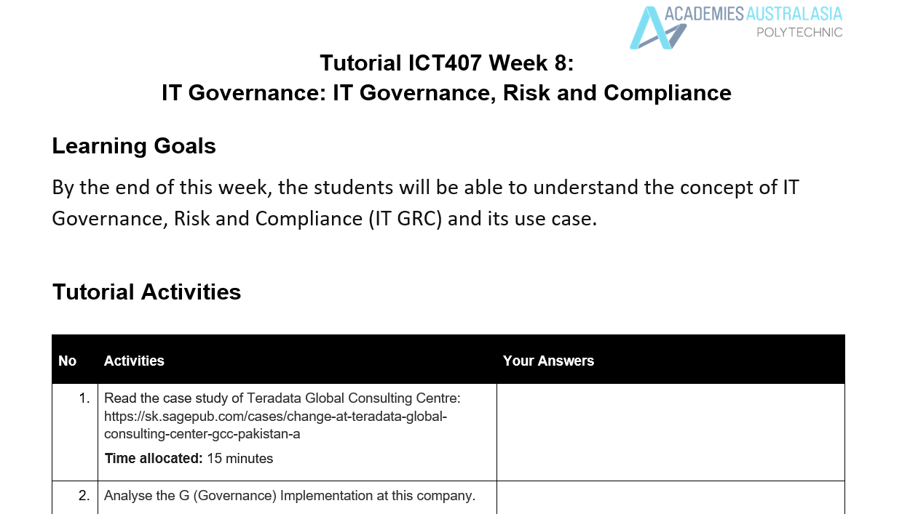

Tutorial Week 8

Slide 19
Tutorial Week 8
1. Governance (G) Implementation at Teradata Global Consulting Center (GCC) Pakistan
Teradata GCC Pakistan's governance implementation faced significant challenges, particularly during its attempt to achieve ISO 27001 certification. Governance in this context refers to how the organization structured its policies, roles, and responsibilities to ensure that information security management aligned with business goals and international standards.

Slide 20
Tutorial Week 8
Initially, the governance approach struggled due to resistance from line managers, who were supposed to enforce the new policies within their teams. The lack of buy-in from these managers indicated a governance gap where responsibilities were not clearly communicated or accepted. The resignation of the original ISMF Chairman further highlighted the governance issues, suggesting that there was a lack of alignment between the governance framework and the organization's culture.

Slide 21
Tutorial Week 8
When Kashif Jadoon took over as the new ISMF Chairman, he introduced a 'reverse strategy' to improve governance. This strategy involved getting a consensus across the organization about the importance of ISO 27001 certification. By making managers accountable and implementing a system where non-compliance would be reported regardless of designation, Kashif strengthened the governance structure. His approach also included motivating employees through competitions and educating them on the business value of certification. This revised governance model was more participative and aimed at building consensus, which ultimately helped in driving the implementation process more effectively.

Slide 22

Tutorial Week 8
2. Risk Management (R) Implementation at Teradata Global Consulting Center (GCC) Pakistan
The risk management implementation at Teradata GCC Pakistan was closely tied to the ISO 27001 certification process, which is inherently focused on identifying and mitigating risks related to information security. Initially, the organization faced significant challenges in managing risks due to the resistance from line managers and their teams. This resistance itself posed a risk to the successful implementation of the certification, as it hindered the adoption of necessary security practices across the organization.

Slide 23
Tutorial Week 8
Under the leadership of Kashif Jadoon, the organization’s approach to risk management became more proactive. By conducting a second internal audit, Kashif’s team was able to identify gaps in the implementation and address them before the final external audit. This internal audit was a crucial risk management activity, as it allowed the team to reassess the organization's readiness and ensure that any outstanding issues were resolved.

Slide 24
Tutorial Week 8
Moreover, by holding managers accountable and enforcing a culture of compliance, Kashif mitigated the risk of non-compliance that could have jeopardized the certification process. The competitions and motivational strategies also served as risk management tools, as they increased employee engagement and reduced the likelihood of resistance. Overall, the revised approach to risk management under Kashif's leadership was more effective, focusing on internal audits, accountability, and employee motivation to ensure the organization was well-prepared for the external audit.

Slide 25

Tutorial Week 8
3. Compliance (C) Implementation at Teradata Global Consulting Center (GCC) Pakistan
Compliance at Teradata GCC Pakistan was centered around achieving ISO 27001 certification, a standard that ensures the organization’s information security management system (ISMS) meets international benchmarks. The initial attempt at compliance faced significant hurdles due to a lack of alignment between the compliance requirements and the organizational culture. Resistance from line managers and a lack of effective leadership contributed to the challenges in meeting compliance standards.

Slide 26
Tutorial Week 8
When Kashif Jadoon became the ISMF Chairman, he took a more structured approach to compliance. He understood that achieving compliance was not just about completing documentation but ensuring that the entire organization adhered to the processes required by the ISO 27001 standard. By making managers accountable and ensuring that compliance was monitored and reported regardless of designation, Kashif created a more rigorous compliance environment.

Slide 27
Tutorial Week 8
The second internal audit conducted by the ISO team under Kashif's leadership was a key component of the compliance strategy. This audit allowed the team to identify and rectify non-compliance issues before the final external audit. Additionally, by educating employees on the business value of compliance and using motivational strategies, Kashif was able to foster a culture of compliance throughout the organization. This approach not only addressed the immediate compliance needs but also set the foundation for ongoing adherence to the standards required by ISO 27001.

